Slide 1
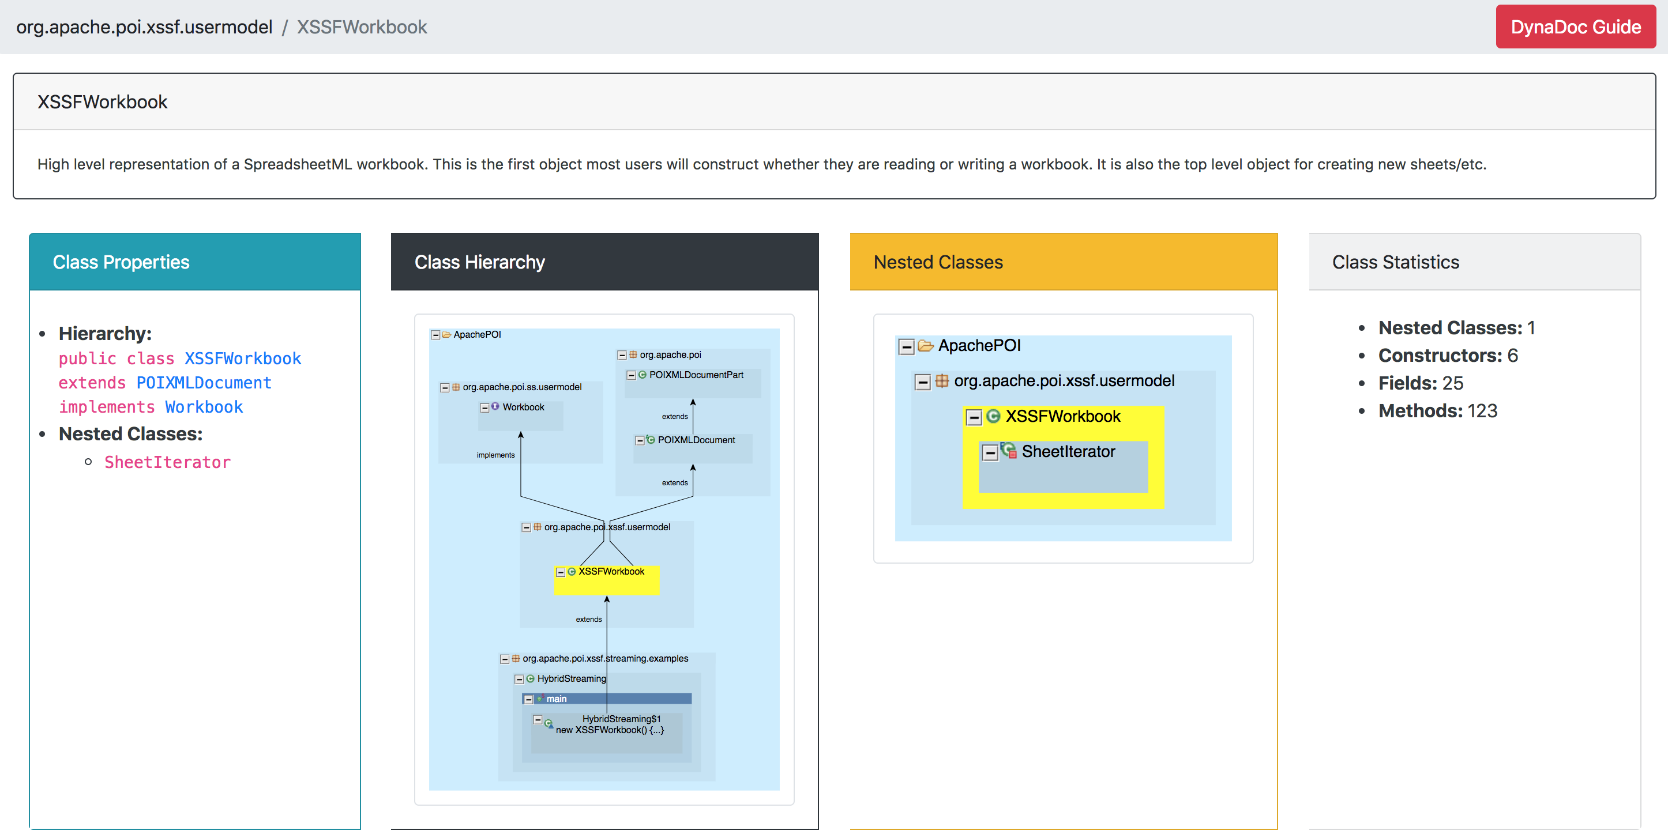
Containing Package Name
User comments for this class
Class Name
The section lists the type hierarchy and the names of nested classes (if any)
This section contains statistics about the class
The graph shows the type hierarchy for the class (highlighted in yellow)
(Clicking the graph will open the full-size graph in a new tab)
The graph shows the nested classes within the class (highlighted in yellow)
(Clicking the graph will open the full-size graph in a new tab)

Slide 2
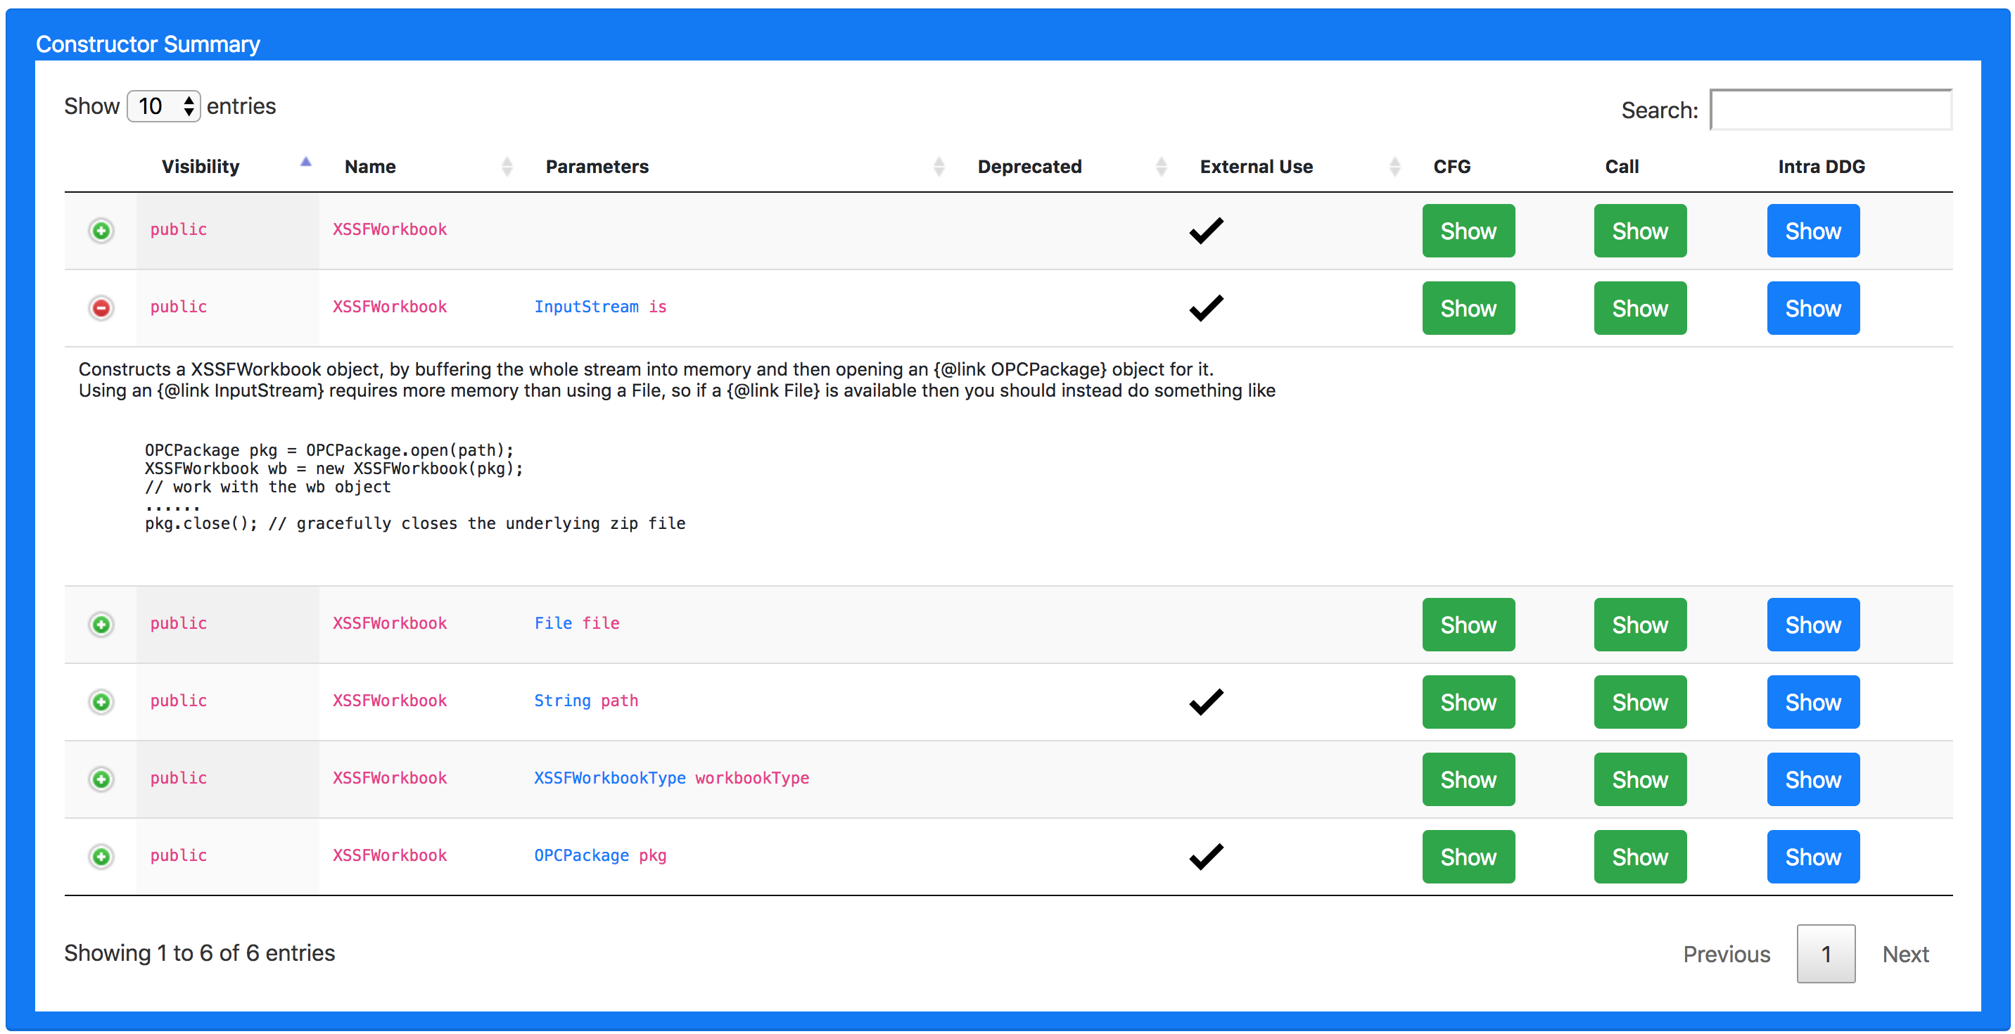
Number of entries shown in one page
Filters the table based on input search term
Whether the constructor is called outside this class
Control Flow Graph
DFG
Show/Hide user comments
User comments for the selected constructor
Data Flow Graph
Call Graph
Pagination

Slide 3
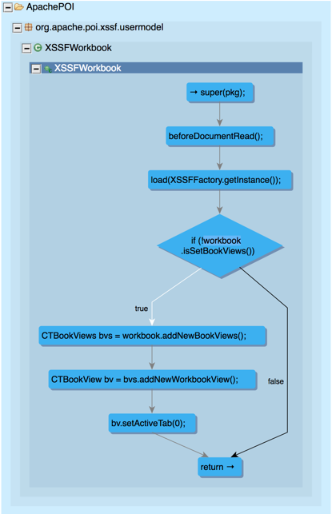
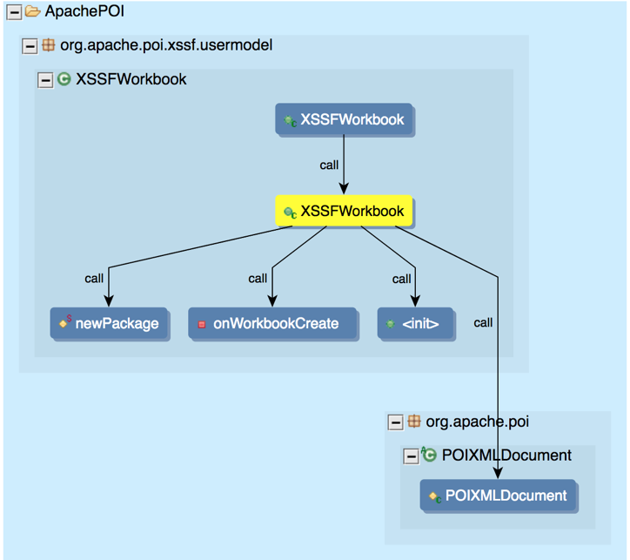
Functions
Statement
Function of Interest
Control Flow Edges
Call Edges
Control Flow Graph
Call Graph

Slide 4
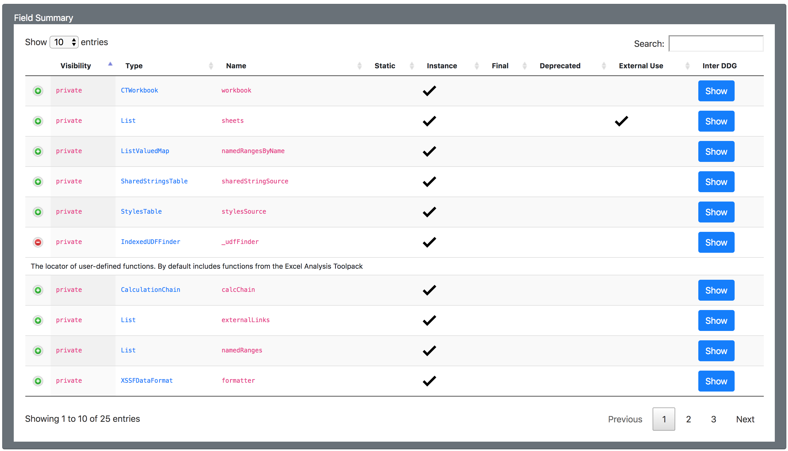
Class Instance Field
Whether the field is used outside this class
Static Field
DFG
Data Flow Graph

Slide 5
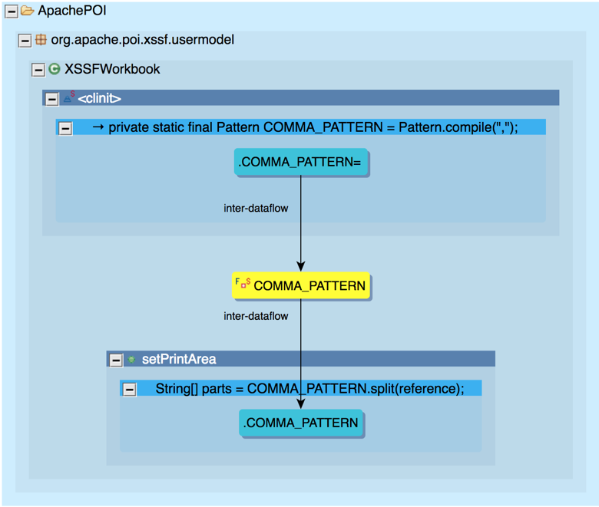
Writes to the field
Data Flow Edges
Field of Interest
Reads from the field

Slide 6
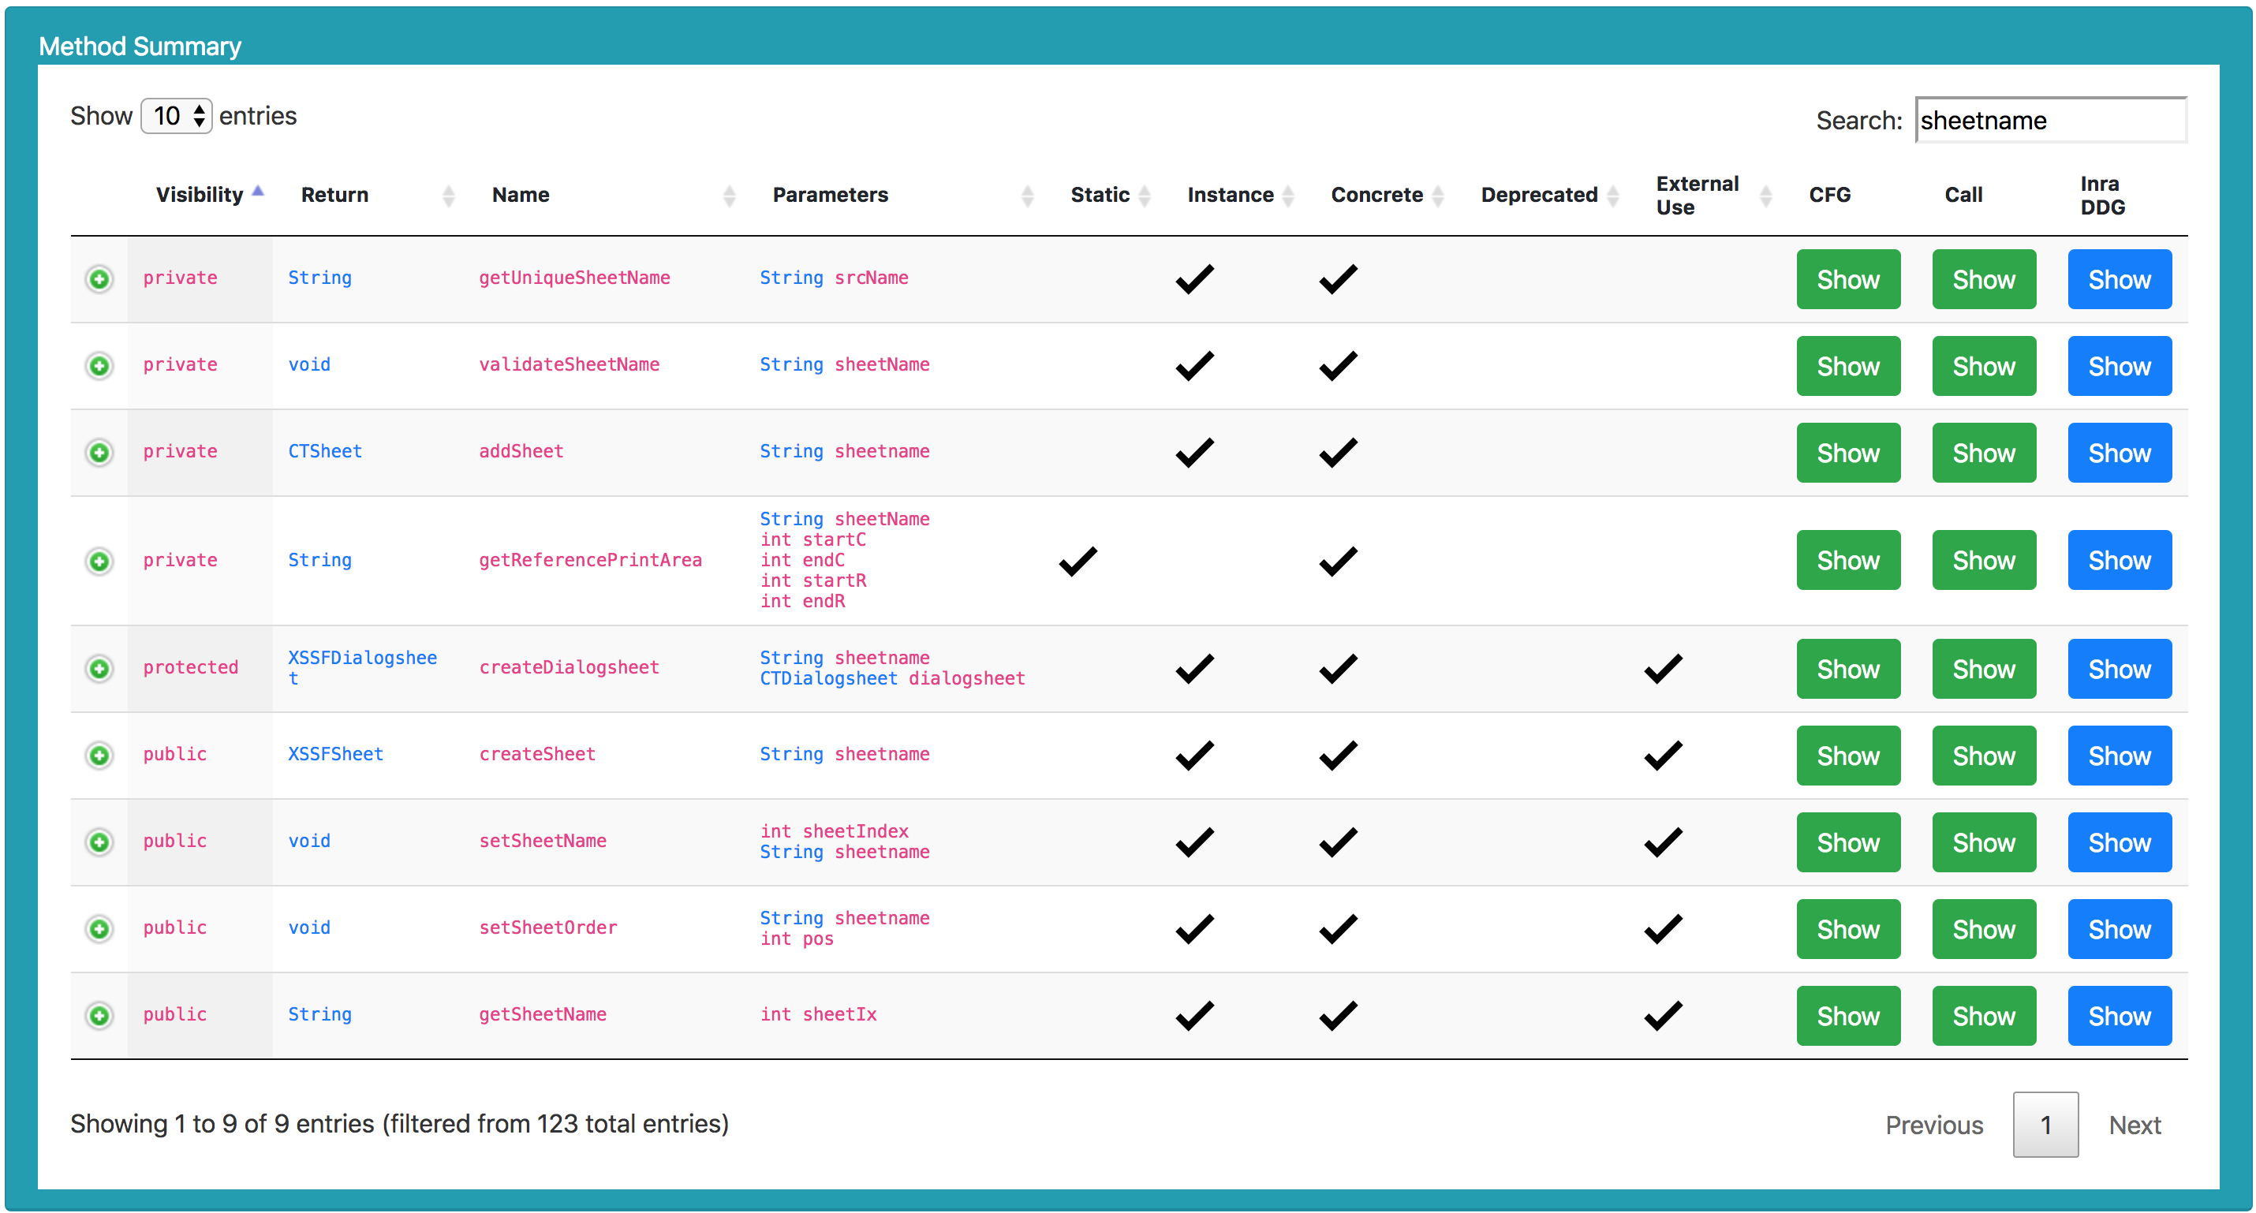
A method that is not abstract
DFG
Data Flow Graph

Slide 7
Parameter
Data-Dependency Edges

Slide 8
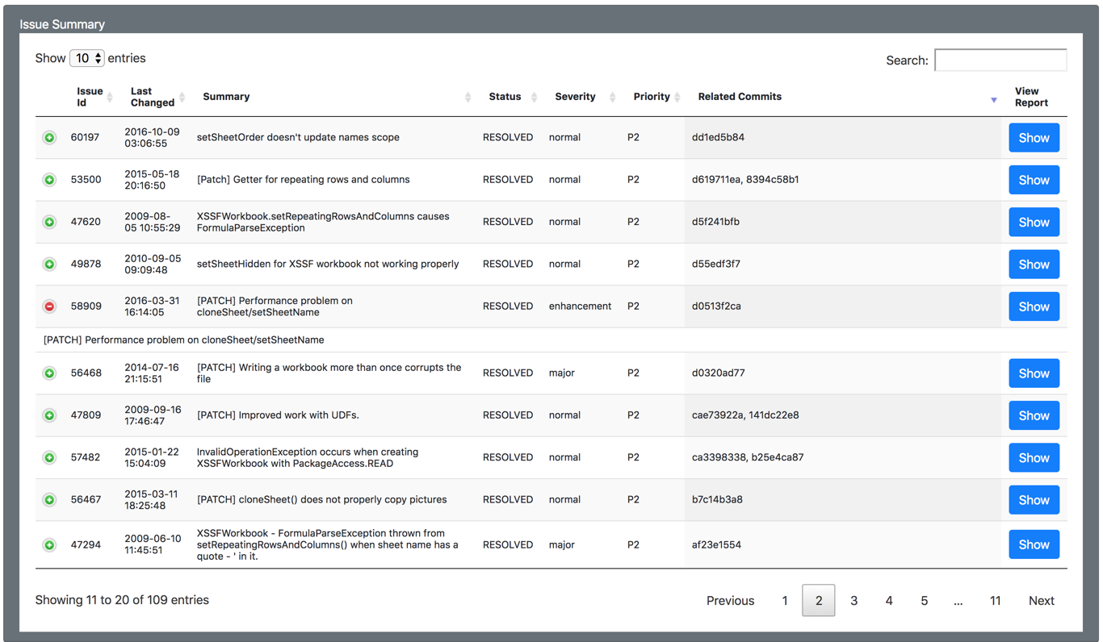
Show/Hide the report summary
Opens the bug report in a new tab

Slide 9
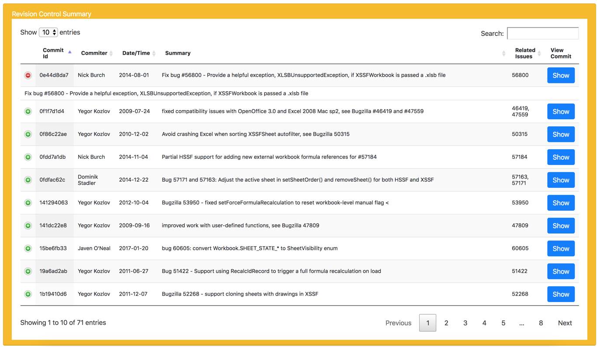
Show/Hide the commit summary
Opens the commit details in a new tab

